Slide 1


Plant Disease Detection using Convolutional Neural Network

Slide 2
AGENDA
Team Member Roles and Responsibilities
Project Description
Team Working Agreement
Personas
Minimal Viable Product (MVP)
Technologies
Algorithms
Diagrams
Improvements made from Professor Feedback
Product Backlog
Metrics
Retrospective
Project Demo
Github Link

Slide 3
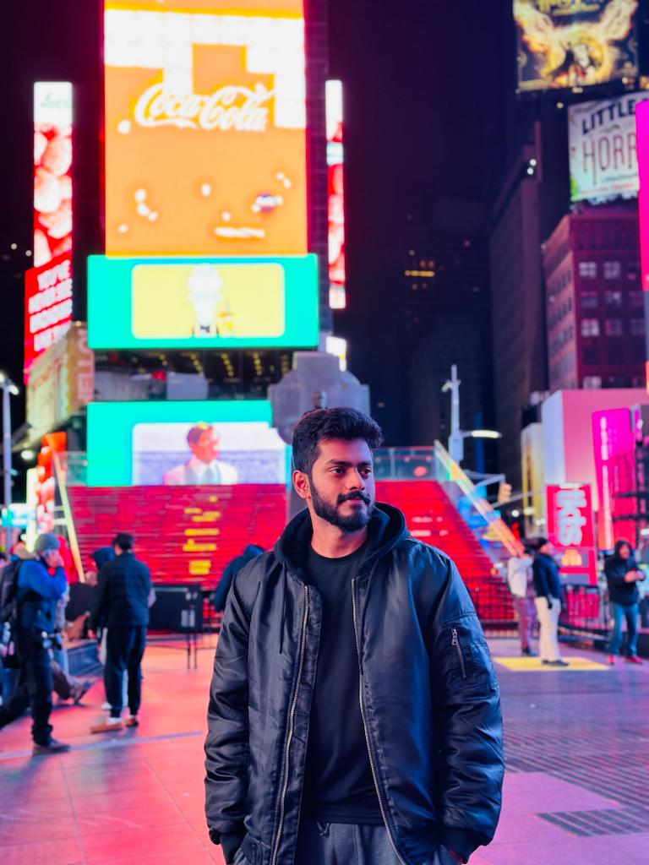
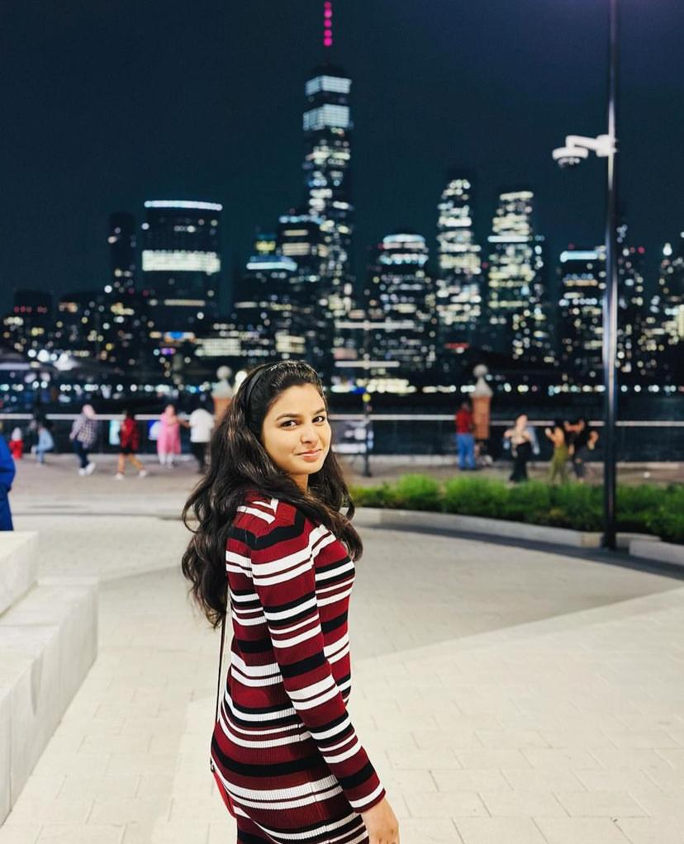
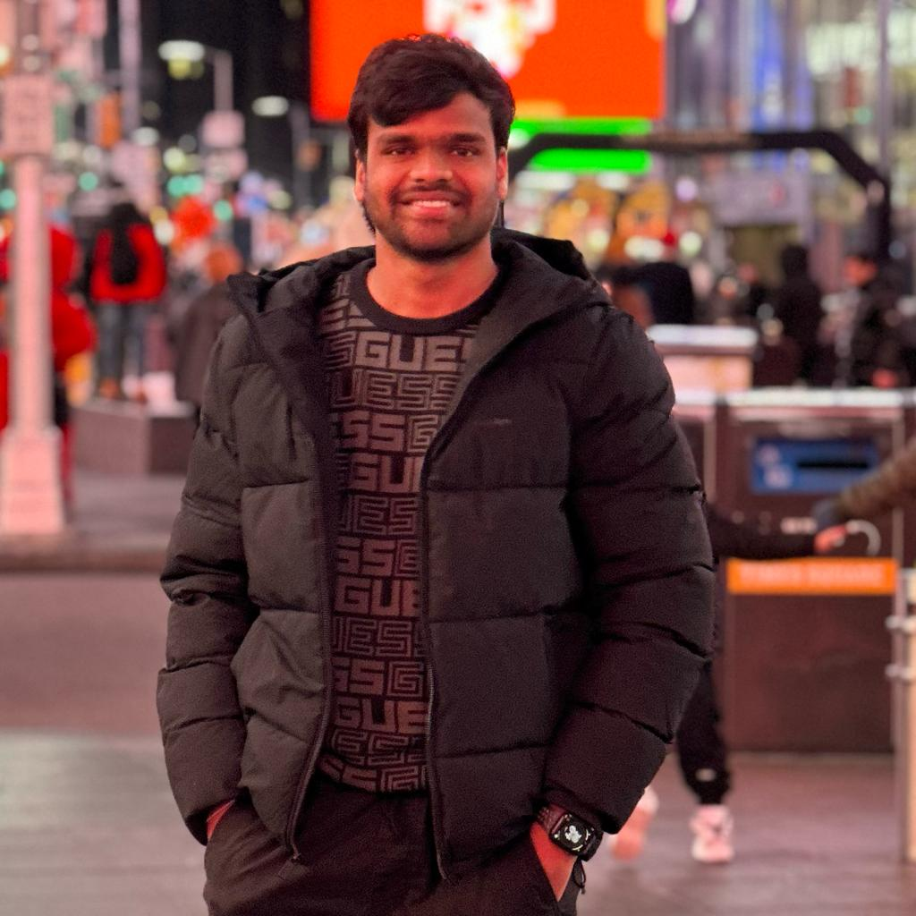
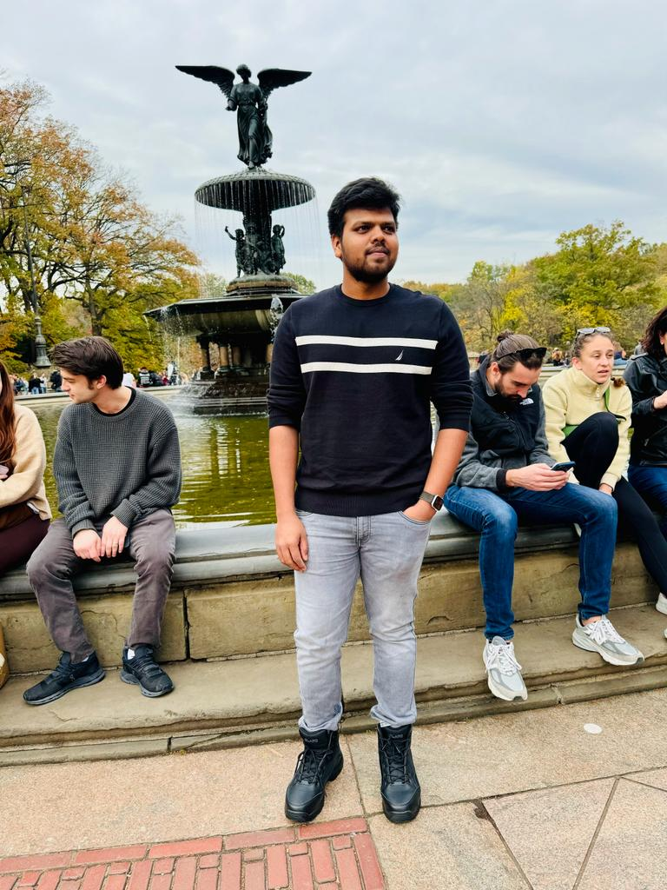
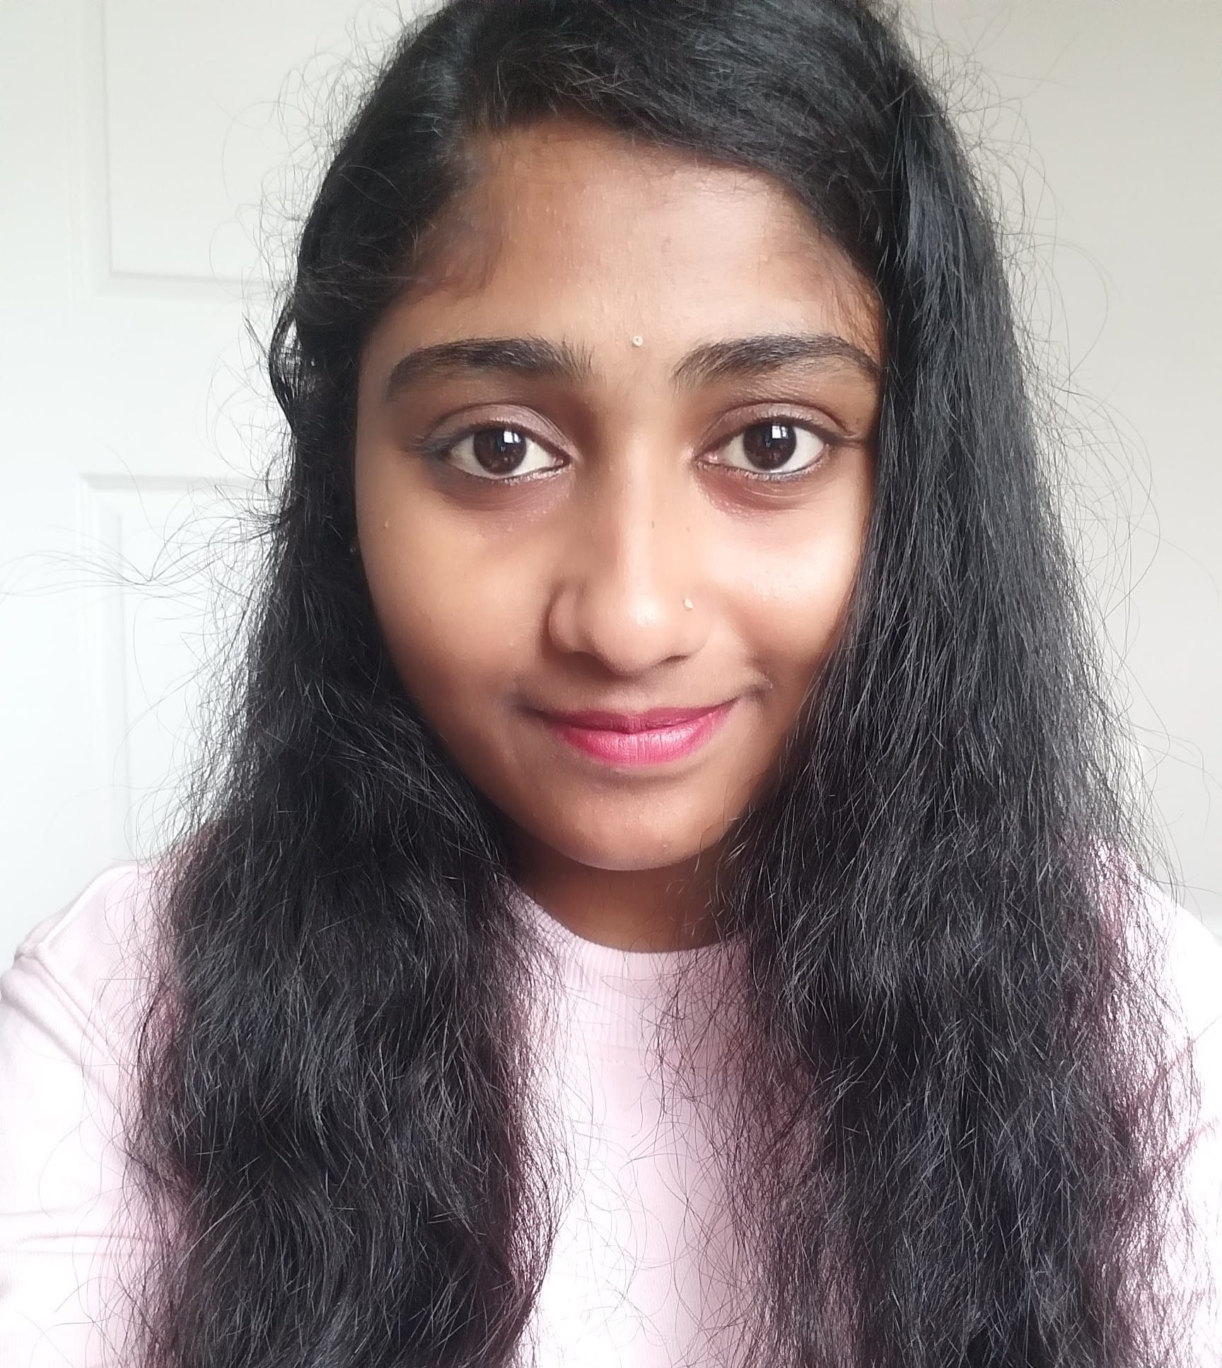
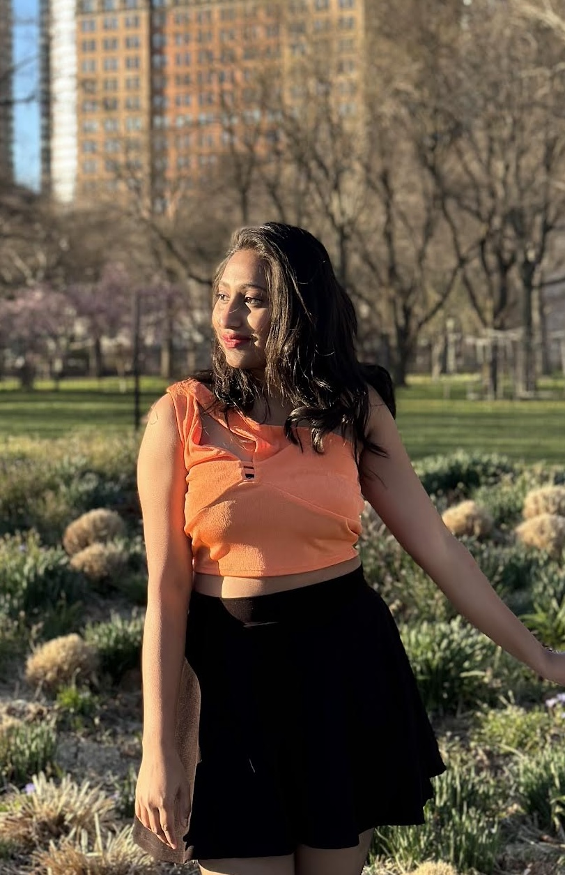
Team Members & roles and responsibilities
Karhik Sura
(Developer)
Shiva Sai
(Data Acquisition and preprocessing)
Katikam Priyanka
(Model Architect)
Tejeshwar Reddy
(Developer)
Neelima Marepalli
(Scrum Master & Quality Analyst)
Tulasi Sherla
(Model trainer and Validator)

Slide 4
Improvements we made from professor feedback
We changed roles and responsibility(we removed the slide that we kept our team members bio.
We changed person's format.
We kept feedback slide that professor asked.
Professor asked about that to keep Burndown chart correctly. So, we implemented correct one.

Slide 5
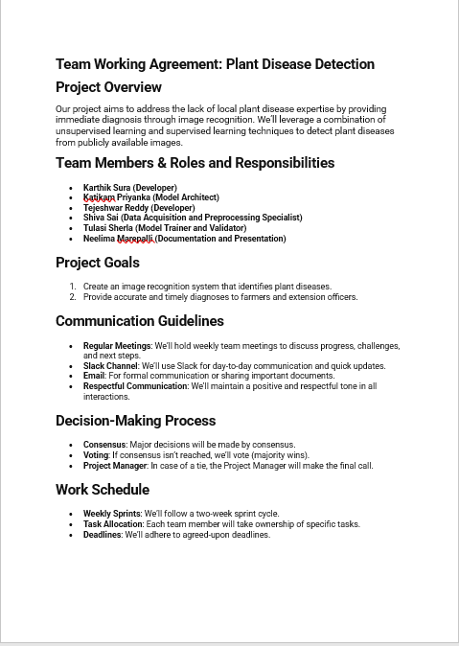
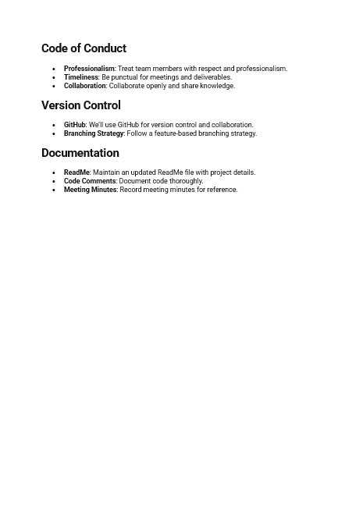
Working Agreement

Slide 6
Project description
Since the past days and in the present too, farmers usually detect the crop diseases with their naked eye which makes them take tough decisions on which fertilizers to use.
It requires detailed knowledge the types of diseases and lot of experience needed to make sure the actual disease detection.
Some of the diseases look almost similar to farmers often leaves them confused.

Slide 7
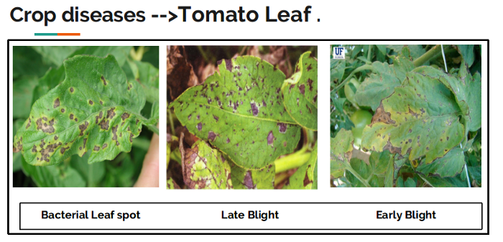
Look at the below image for more understanding.
They look the same and almost similar. In case the farmer makes wrong predictions and uses the wrong fertilizers or more than the normal dose (or) threshold or Limit (every plant has some threshold fertilizers spraying to be followed), it will mess up the whole plant (or) soil and cause enough damage to plant and fields.

Slide 8
So, How to prevent this from happening?
To prevent this situation, we need better and perfect guidance on which fertilizers to use, to make the correct identification of diseases, and the ability to distinguish between two or more similar types of diseases in visuals.
This is where Convolution Neural Networks comes handy. In short CNN

Slide 9

Convolution Neural Network
In deep learning, a convolutional neural network is a class of deep neural networks, most commonly applied to analyzing visual imagery. They are also known as shift invariant or space invariant artificial neural networks, based on their shared-weights architecture and translation invariance characteristics.

Slide 10







Tools Used

Slide 11
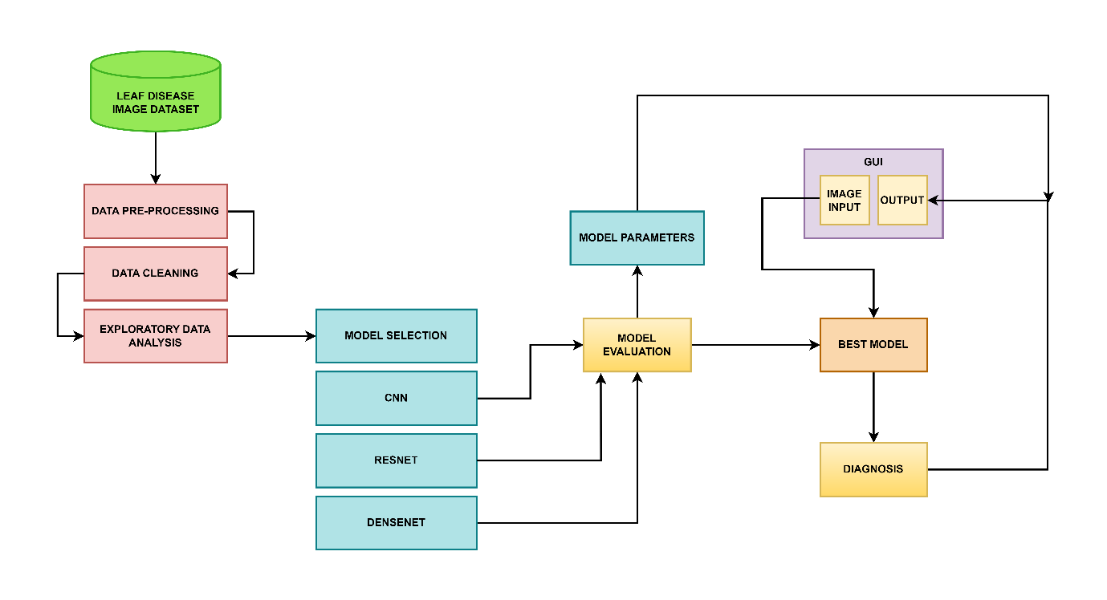
Architecture Diagram

Slide 12
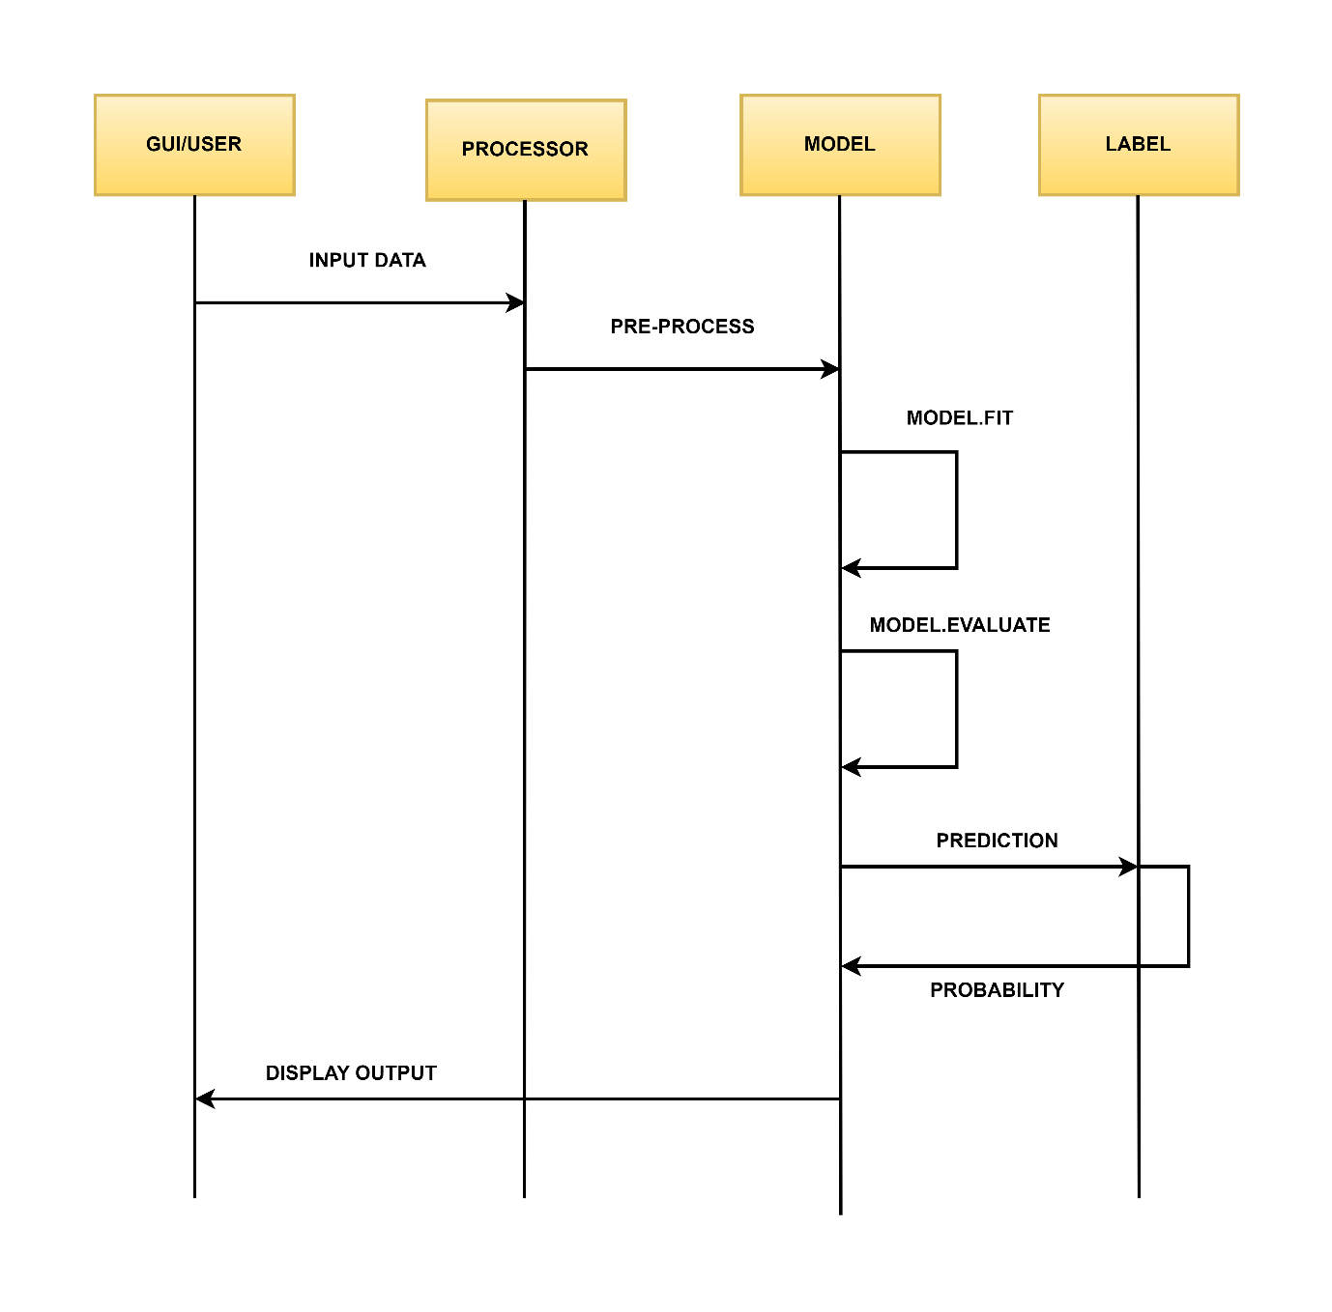
SEQUENCE DIAGRAM

Slide 13
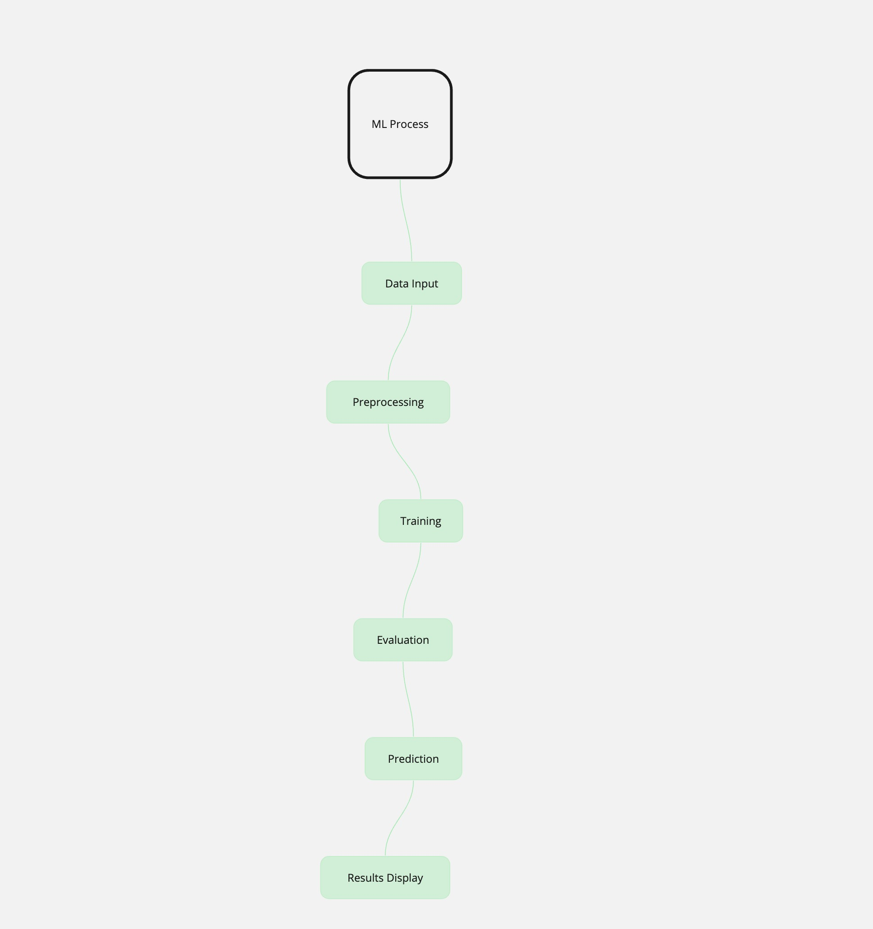
CONCEPT DIAGRAM

Slide 14
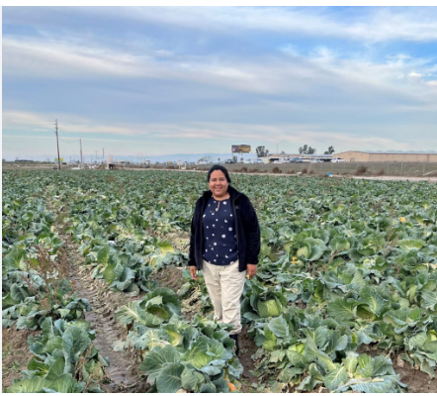
Personas
Maria - Small-Scale Farmer
Age: 35
Marital Status: Married
Location: Rural community, climate with distinct wet and dry seasons.
Livelihood: Manages a five-acre farm cultivating tomatoes, potatoes, and peppers.
Goals: Enhance her family’s standard of living through improved farming techniques and increased crop yields.
Motivation: Driven to boost income through effective disease management and innovative farming practices.

Slide 15
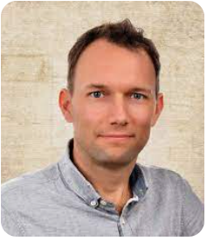
personas
John - Agricultural Extension Officer
Age: 40
Marital Status: Married
Location: Serves multiple farming communities; often travels between remote areas.
Profession: Provides support and advice to local farmers to enhance their agricultural practices.
Goals: Seek reliable tools for accurate plant disease diagnosis and provide educational resources for sustainable disease management.
Motivation: Committed to improving farm productivity and regional food security through enhanced agricultural practices.

Slide 16
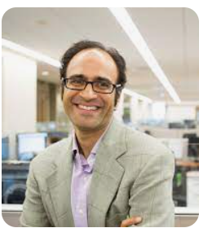
personas
Dr. Patel - Plant Pathologist
Age: 39
Marital Status: Married
Location: Based at a research university with a specialized agricultural science department.
Profession: Leads research on crop disease patterns and pathogen evolution.
Goals: Needs advanced analytics tools for large-scale image data analysis to identify trends in disease prevalence.
Motivation: Aims to advance scientific knowledge and develop effective plant disease management strategies to improve global agricultural resilience.

Slide 17
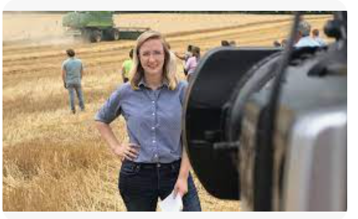
personas
Sarah - Agri-Tech Entrepreneur
Age: 37
Marital Status: Married
Location: Urban, within a tech startup hub.
Profession: CEO of a startup focused on developing agricultural technology solutions.
Goals: Develop a scalable and integrable plant disease detection system with customizable API/SDK for broader tech ecosystem connectivity.
Motivation: Enthusiastic about creating technology-driven solutions for agricultural challenges, aiming to build a successful business that promotes sustainable farming practices.

Slide 18
MVP: Minimum Valuable Product
Some of the Features in our MVP of the Project are:
Creation of user interface for user authentication using login option
After successful authentication it will redirect to HOME Page
Creation of Menu option:
HOME
DETECTOR
Option to upload images for disease detection.
Option to logout from the application.

Slide 19
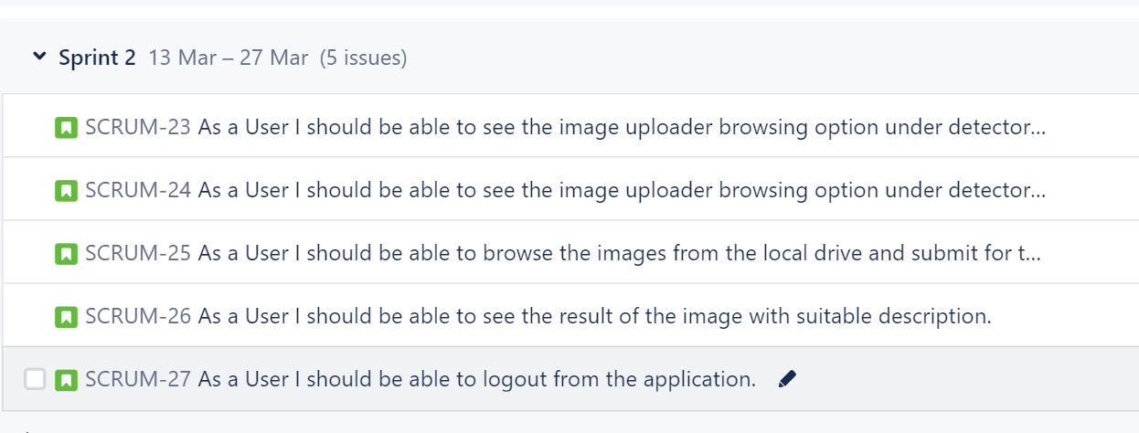
Sprint 2 Recap

Slide 20
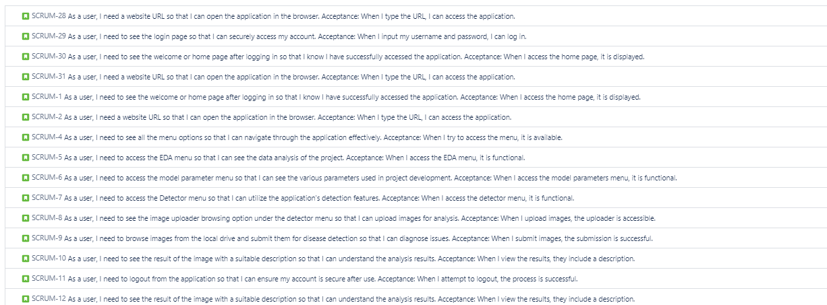
PRODUCT BACKLOG

Slide 21
user STORIES
Issue Type | ID | Summary | Place
As a User | 1 | As a user, I need a website URL so that I can open the application in the browser. Acceptance: When I type the URL, I can access the application. | Web Browser
As a User | 2 | As a user, I need to see the login page so that I can securely access my account. Acceptance: When I input my username and password, I can log in. | Login Page
As a User | 3 | As a user, I need to see the welcome or home page after logging in so that I know I have successfully accessed the application. Acceptance: When I access the home page, it is displayed. | Home Page
As a User | 1 | As a user, I need a website URL so that I can open the application in the browser. Acceptance: When I type the URL, I can access the application. | Web Browser
As a User | 2 | As a user, I need to see the login page so that I can securely access my account. Acceptance: When I input my username and password, I can log in. | Login Page
As a User | 3 | As a user, I need to see the welcome or home page after logging in so that I know I have successfully accessed the application. Acceptance: When I access the home page, it is displayed. | Home Page
As a User | 1 | As a user, I need a website URL so that I can open the application in the browser. Acceptance: When I type the URL, I can access the application. | Web Browser

Slide 22
Issue Type | ID | Summary | Place
As a User | 4 | As a user, I need to see all the menu options so that I can navigate through the application effectively. Acceptance: When I try to access the menu, it is available. | Home Page
As a User | 5 | As a user, I need to access the EDA menu so that I can see the data analysis of the project. Acceptance: When I access the EDA menu, it is functional. | Home Page
As a User | 6 | As a user, I need to access the model parameter menu so that I can see the various parameters used in project development. Acceptance: When I access the model parameters menu, it is functional. | Home Page

Slide 23
Issue Type | ID | Summary | Place
As a User | 7 | As a user, I need to access the Detector menu so that I can utilize the application's detection features. Acceptance: When I access the detector menu, it is functional. | Home Page
As a User | 8 | As a user, I need to see the image uploader browsing option under the detector menu so that I can upload images for analysis. Acceptance: When I upload images, the uploader is accessible. | Detector Page
As a User | 9 | As a user, I need to browse images from the local drive and submit them for disease detection so that I can diagnose issues. Acceptance: When I submit images, the submission is successful. | Detector Page

Slide 24
Issue Type | ID | Summary | Place
As a User | 10 | As a user, I should be able to see the result of the image with a suitable description so that I can understand the analysis results. Acceptance: When I view the results, they include a description. | Detector Page
As a User | 11 | As a user, I should be able to logout from the application so that I can ensure my account is secure after use. Acceptance: When I attempt to logout, the process is successful. | HomePage
As a User | 10 | As a user, I should be able to see the result of the image with a suitable description so that I can understand the analysis results. Acceptance: When I view the results, they include a description. | Detector Page

Slide 25
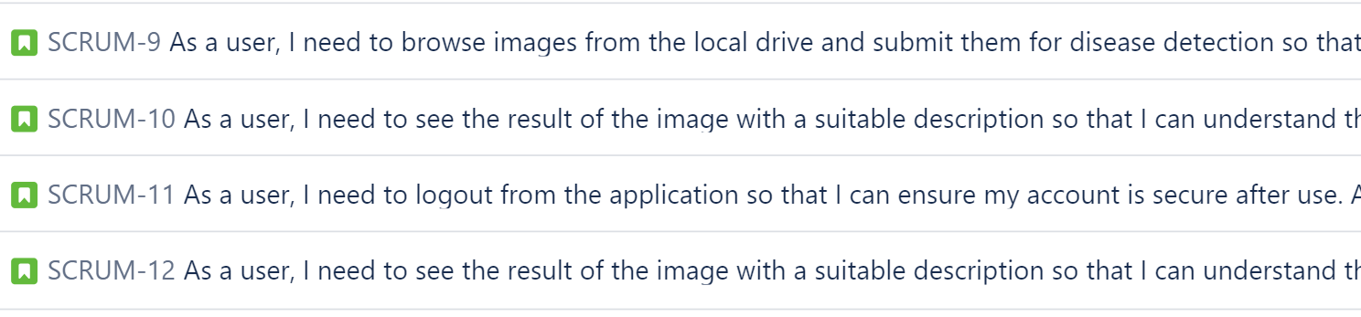
Sprint 3 Backlog (Stories completed)

Slide 26
TEST CASES
ID | Unit of Test | Scenario | Test Data | Steps to be Expected | Expected Result
TC2 | Disease Prediction | Successful Prediction | Email: example@example.com, Symptoms: valid symptoms | Homepage -> Login -> Disease Prediction -> Submit | User should receive a disease prediction based on the symptoms provided.
TC3 | Disease Prediction | Prediction without Login | Symptoms: valid symptoms | Homepage -> Disease Prediction -> Submit | User should be prompted to log in before receiving a disease prediction.
TC4 | Disease Prediction | Invalid Symptoms | Email: example@example.com, Symptoms: invalid | Homepage -> Login -> Disease Prediction -> Submit | User should see an error message indicating invalid symptoms and suggestions for correcting them.
TC5 | Disease Info | Access Disease Information | User logged in | Homepage -> Login -> Disease Info | User should be able to view information about various diseases.
TC6 | Disease Info | Access Disease Information | User not logged in | Homepage -> Disease Info | User should be prompted to log in to access detailed disease information.

Slide 27
ID | Unit of Test | Scenario | Test Data | Steps to be Expected | Expected Result
TC7 | Upload Data | Successful Upload | Email: example@example.com, Data: valid file | Homepage -> Login -> Upload Data -> Submit File | User should successfully upload the file and receive a confirmation message.
TC8 | Upload Data | Attempt Upload Without Login | Data: valid file | Homepage -> Upload Data -> Submit File | User should be prompted to log in before uploading data.
TC9 | Upload Data | Invalid Data File | Email: example@example.com, Data: invalid file | Homepage -> Login -> Upload Data -> Submit File | User should see an error message indicating the file is invalid and suggestions for acceptable formats.
TC10 | Account Management | Forgot Password (Not Logged In) | Click on "Forgot Password" link | Homepage -> Forgot Password | User should be redirected to the password reset page to enter their registered email ID.
TC11 | Account Management | Logout | Logged in | Click on "Logout" or "Sign Out" | User should be successfully logged out and redirected to the login page.

Slide 28
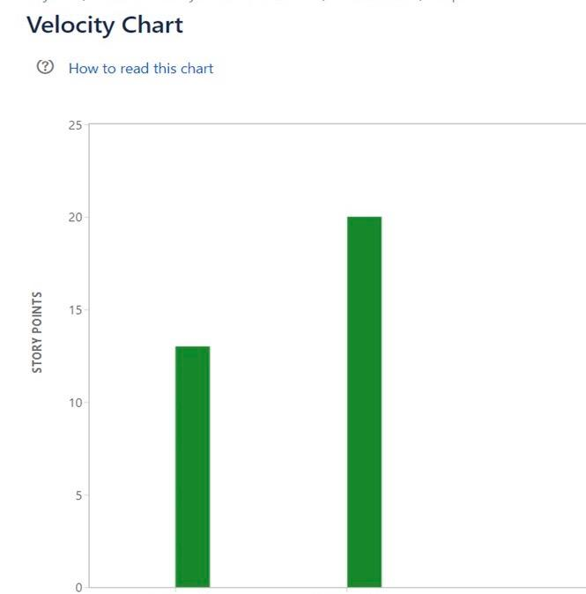
Metrics

Slide 29
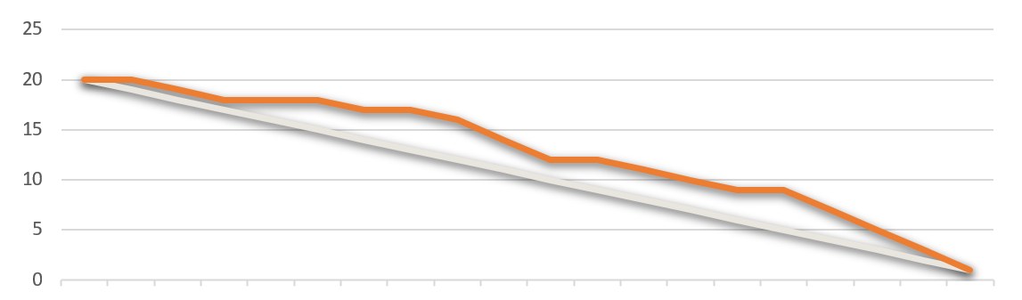
Burndown chart

Slide 30
Retrospective
What went well?
▪ We as a team have planned to keep our objective simple to finish and produce what was expected.
▪ Team had good time working together.
▪ Active response from team to get involved in tasks with clear thoughts.
▪ The key was participation and motivation to complete task in time and every member knew what they had to do.
▪ We had several discussion sessions.
▪ Overall, every meeting session is effectively used to gain progress and complete sprint on time.

Slide 31
What Could Be Improved?
We frequently try to communicate to discuss about project and advancements even after the sprint completion.
Setting up time limit for the tasks and learning from previous semester student’s sprints performance to make improvements and where can we be better.

Slide 32
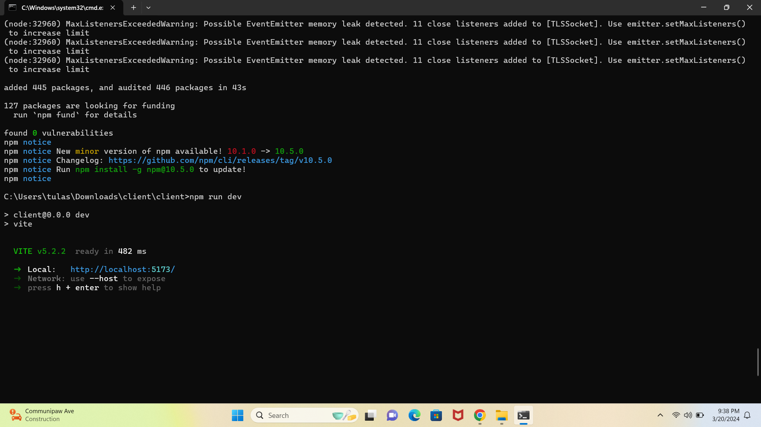
PROJECT DEMO SPRINT 3

Slide 33
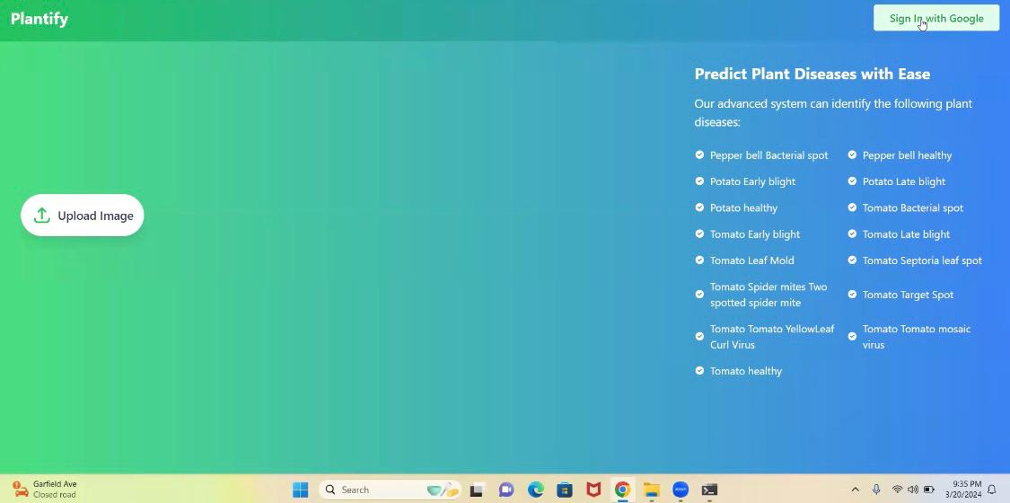
This is how our home page looks like

Slide 34
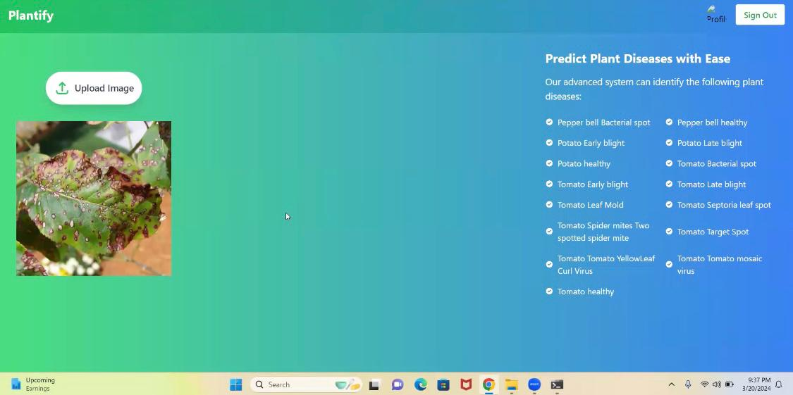
Customers can able to upload picture here

Slide 35
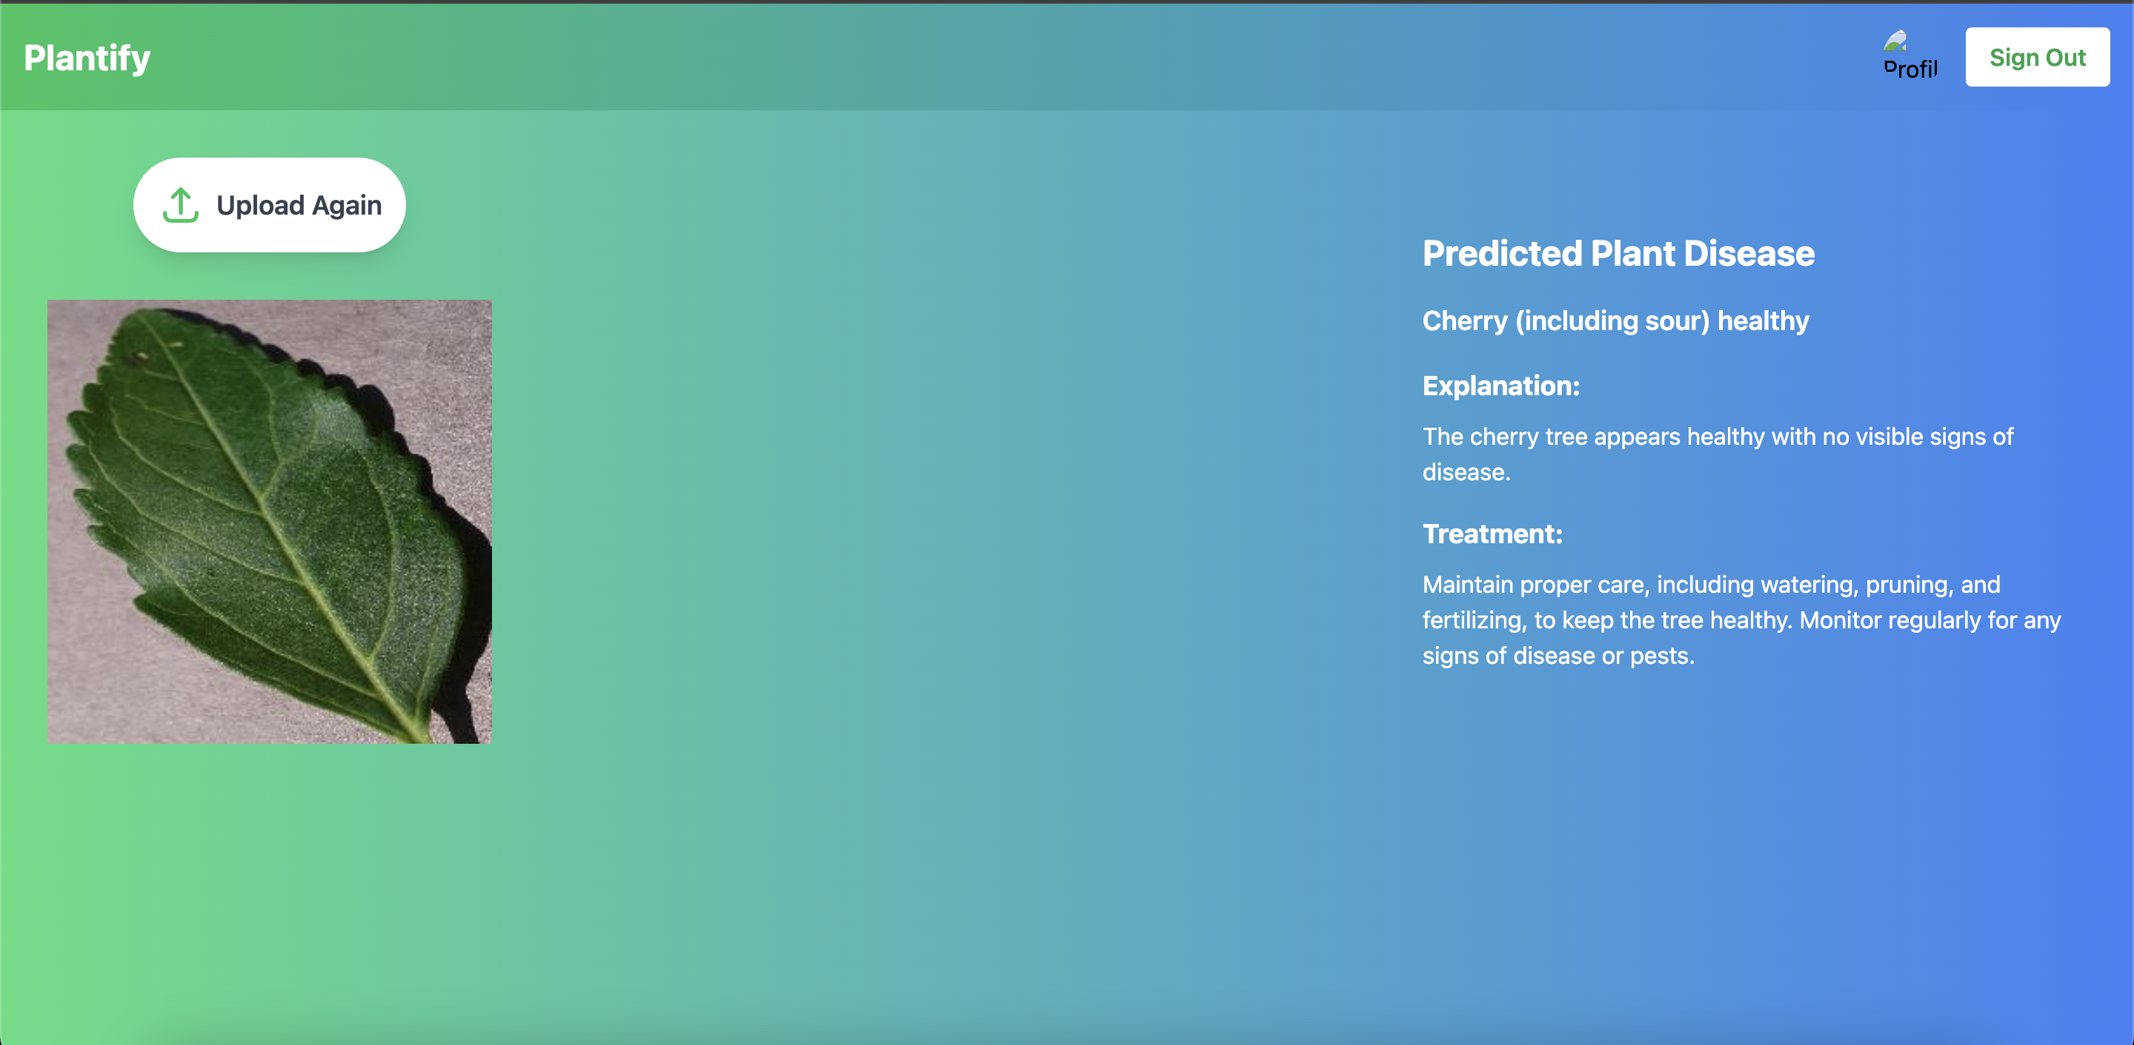
Customers getting prediction for their image

Slide 36
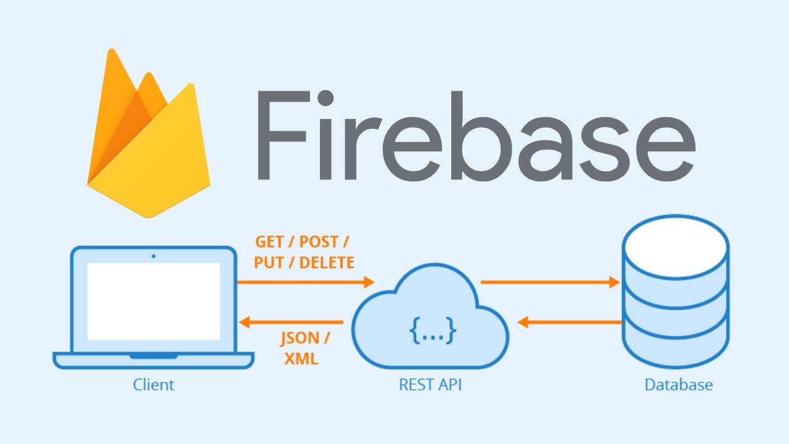
API

Slide 37
WIKI Page
https://github.com/surakarthi/Group-2-Cs-691/wiki/Welcome-to-the-Group%E2%80%902%E2%80%90Cs%E2%80%90691-wiki!

Slide 38
Thank You

